Slide 1
Lecture 1 – Recap

Slide 2
Raymond Williams (Culture and Society)
Late 18th century. Industrial Revolution
Industry -- as an institution
Democracy – as a political word, not just theoretical or literary
Class – modern social structure we recognise as class (Lower orders/class, middle class, working class). Class, not rank.
Art – a special kind of truth. Imaginative, unique. Aesthete/aesthetics. Talent, genius

Slide 3
Culture – meant a “natural growth.” training smthg. to grow – including training a human being. Comes to mean a thing in itself
a general state of mind/being. Close to perfection
General state of intellectual development in society as a whole
A body of arts – this dance/music is “our” culture
A whole way of life/physical and spiritual. Comes to be a battleground of shame/pride

Slide 4
Distinguish three levels of culture
the lived culture of a particular time and place, only fully accessible to those living in that time and place.
recorded culture, of every kind, from art to the most everyday facts: the culture of a period.
the factor connecting lived culture and period cultures, the culture of the selective tradition

Slide 5
Where is Culture?
It is in the organization of production of society, the structure of the family, and institutions which express or govern social relationships, the characteristic forms through which members of the society communicate. Cultural artefacts cannot then be read only in aesthetic terms.

Slide 6
To read literary texts with social and historical analyses
Historical circumstances, social traditions, and the media work together to create a cultural milieu in which certain sets of beliefs are either reinforced or questioned in the text

Slide 7
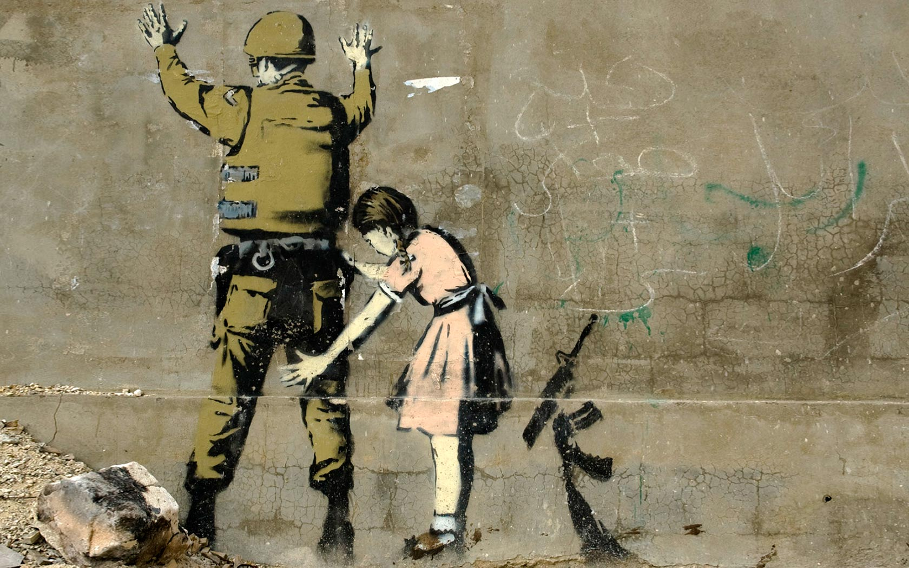
Banksy

Slide 8
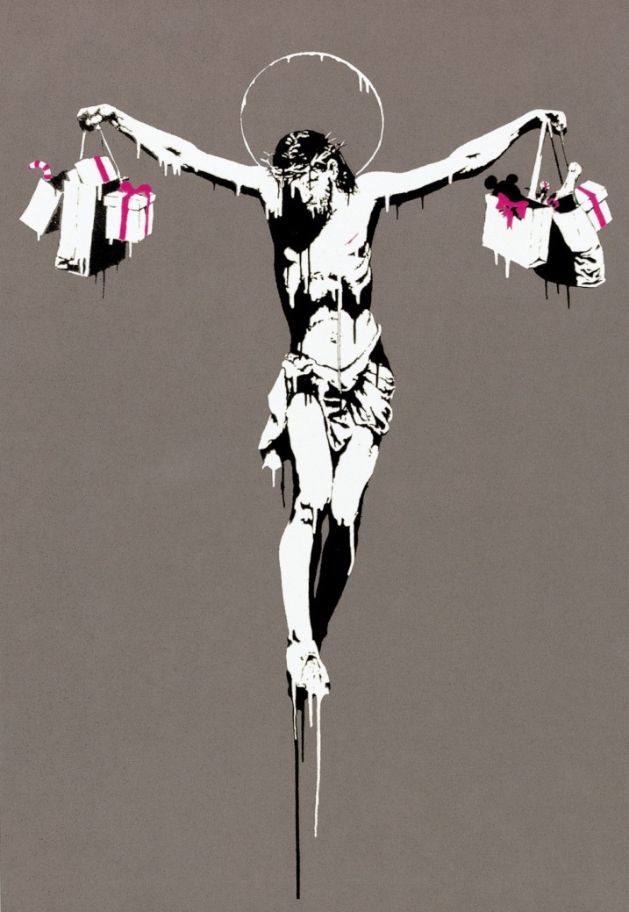

Slide 9
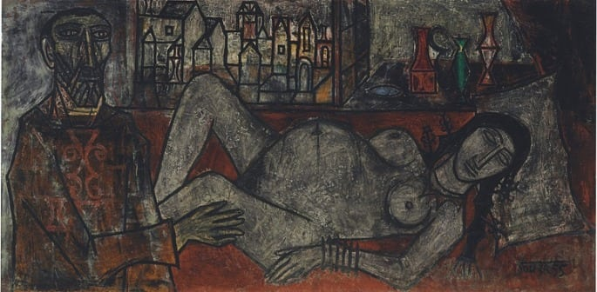
Souza – “Birth” 2015, 3.1 million euros

Slide 10
A few ideas
High artistic/cultural merit vs low culture/literature
Exclusivity of access, control over means of production, rarity
Artist vs artisan, skills vs talent/genius
Distance from the body (Herbert Marcuse)

Slide 11
Introduction to Human Sciences
Literature Module
Lecture 2: “Good” vs “Bad” Culture

Slide 12
What does it mean then to study culture/s and its manifestations?
Strong interlinkages of Culture with Power
The middle class – history of intervention through culture
Aristotle – truth arrived at through knowledge
Knowledge should direct practice in arts and science

Slide 13
Hierarchies of Knowledge
Nadir – Functional knowledge of everyday necessities of life (food, clothes, shelter, sex)
Zenith – Philosophic knowledge that has no purpose outside itself (affords men felicity and leisure)
Fundamental break between the useful and the beautiful
Beautiful, “pure” theory congeals into an independent activity

Slide 14
Practice is no longer guided by truth arrived at through knowledge. Labour vs contemplation
An economic hierarchy of labour can be traced
“lower” order activities divorced from beauty and thought produce a class of men dedicated to production of goods
Distance from physical labour produces class

Slide 15
Wealth/well-being depend on opaque market forces, while he (worker) has no access to beauty
The world of necessity, of everyday provision for life is unfree, inconsistent
The man forced to engage in this entirely is slave to other men and things
Man perforce has to exist for smthg outside of him
In a field of opposing social interests

Slide 16
Class Structures are produced
Caste structures perpetuate this division
Peasant/Serf vs Priest/Brahmin
Physical needs are not bad per se – they are crucially fulfilled in a bad, inequal order
In capitalism, the commodity attempts to replace truth/beauty
Science/technology vs Humanities, Philosophy

Slide 17
Pursuit of the Highest good/truth is a “luxury”
So, we end up with a hierarchy of truths mirrored in a social hierarchy
In the face of social contradictions, Idealism retreats – in Aristotle
The material world should be transformed by the truths revealed by knowledge of Ideas

Slide 18
History of Idealism is the History of coming to terms with the established order
CULTURE is that negotiation
It mediates between Idealism and material conditions of exploitation and profiteering

Slide 19
Capitalist Epoch
Universal validity of “culture”
You are not born into labour/leisure
You are in a pure exchange of labour and services i.e., your personal qualities/needs don’t matter except as commodities
Your higher ideas – to God, truth, leisure, beauty are tested against a universal set of values we call “culture”

Slide 20
Desert of the Real
Here, sameness is essential
Rather minute differences that ultimately produce sameness
Fashions that produce a rhetoric of individual choice
We basically watch the same movie again and again
Egs. Modern day ones – Ranbir Kapoor’s entire career is about watching a grown petulant boy hopefully becoming a man
Beards, Slim Pants, Coffee, Trekking, photography, Graphic Design – Hipster

Slide 21
A universally obligatory, eternally better, more valuable world must constantly be affirmed – a world removed from the facticity of daily struggles, yet realizable from within each individual without transforming the world
“Civilization and Culture” – where Sublime Beauty and antagonistic relations of existence are stabilized and pacified

Slide 22
Culture – Supposed to be concerned with every individual’s claim to happiness
Root of Culture – hierarchies of antagonisms
Society reproduces itself through economic competition
Here, happier social existence is rebellion – Maruti factory, Amazon, Bangladeshi Sweatshops, women vs goddesses, Refugees vs migrants

Slide 23
Culture belongs to he who has internalized a proper mode of behaviour
He who comprehends the truths of humanity as battle cry is a rebel (Nargis vs Satyajit Ray)
Culture – ennobles, speaks of the dignity and freedom of man without freeing him

Slide 24
Beauty and truth, contemplation and intellection then are “cultural” activities
Both sublimated and internalized
Neither forms allow real material conditions to change
Culture perpetuates forms of systemic/epistemic oppression

Slide 25
At the same time, culture is that which escapes the confines and language of power disrupting the narrative of political and capitalist formation.
Such escapes are short lived, and quickly co-opted
“Azaadi Song” – Kanhaiya Kumar, Dub Sharma, Gully boy

Slide 26
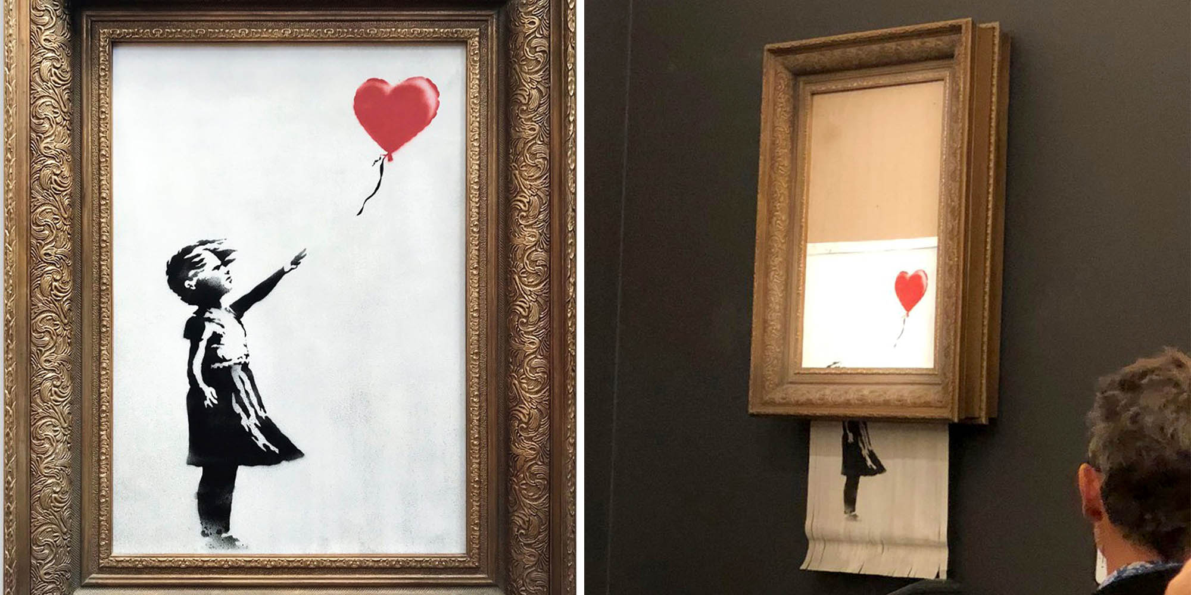

Slide 27
Pop art/Culture
Popular art is not art that has attempted and failed to be real art, but art that operates within the confines of the popular
While retaining much in common with folk art, it became an individual art, existing within a literate commercial culture

